Slide 1
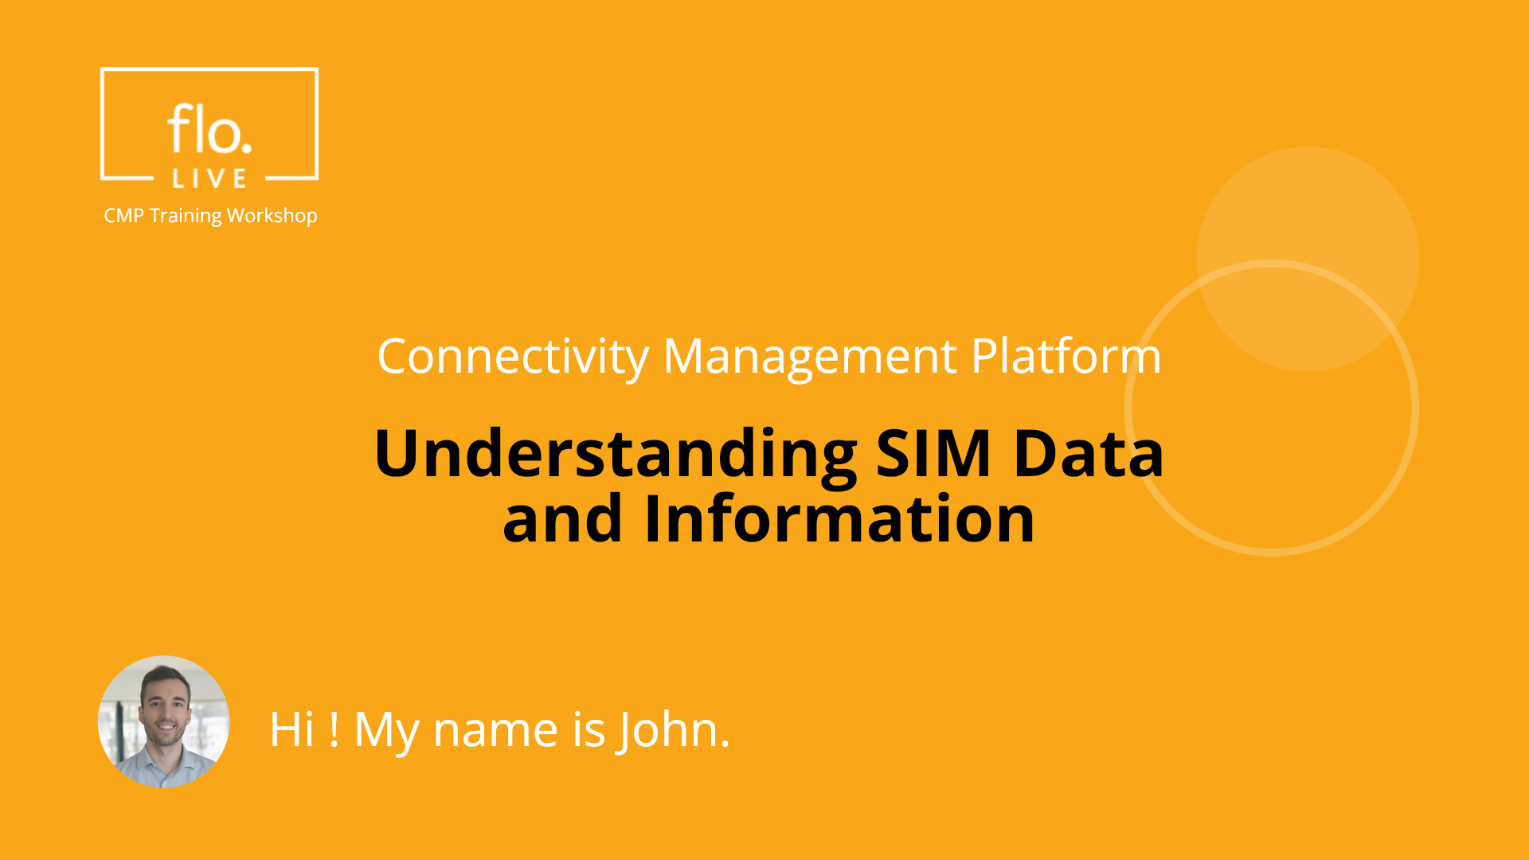
Notes:
Hi. My name is John and welcome to the CMP Training Workshop

Slide 2
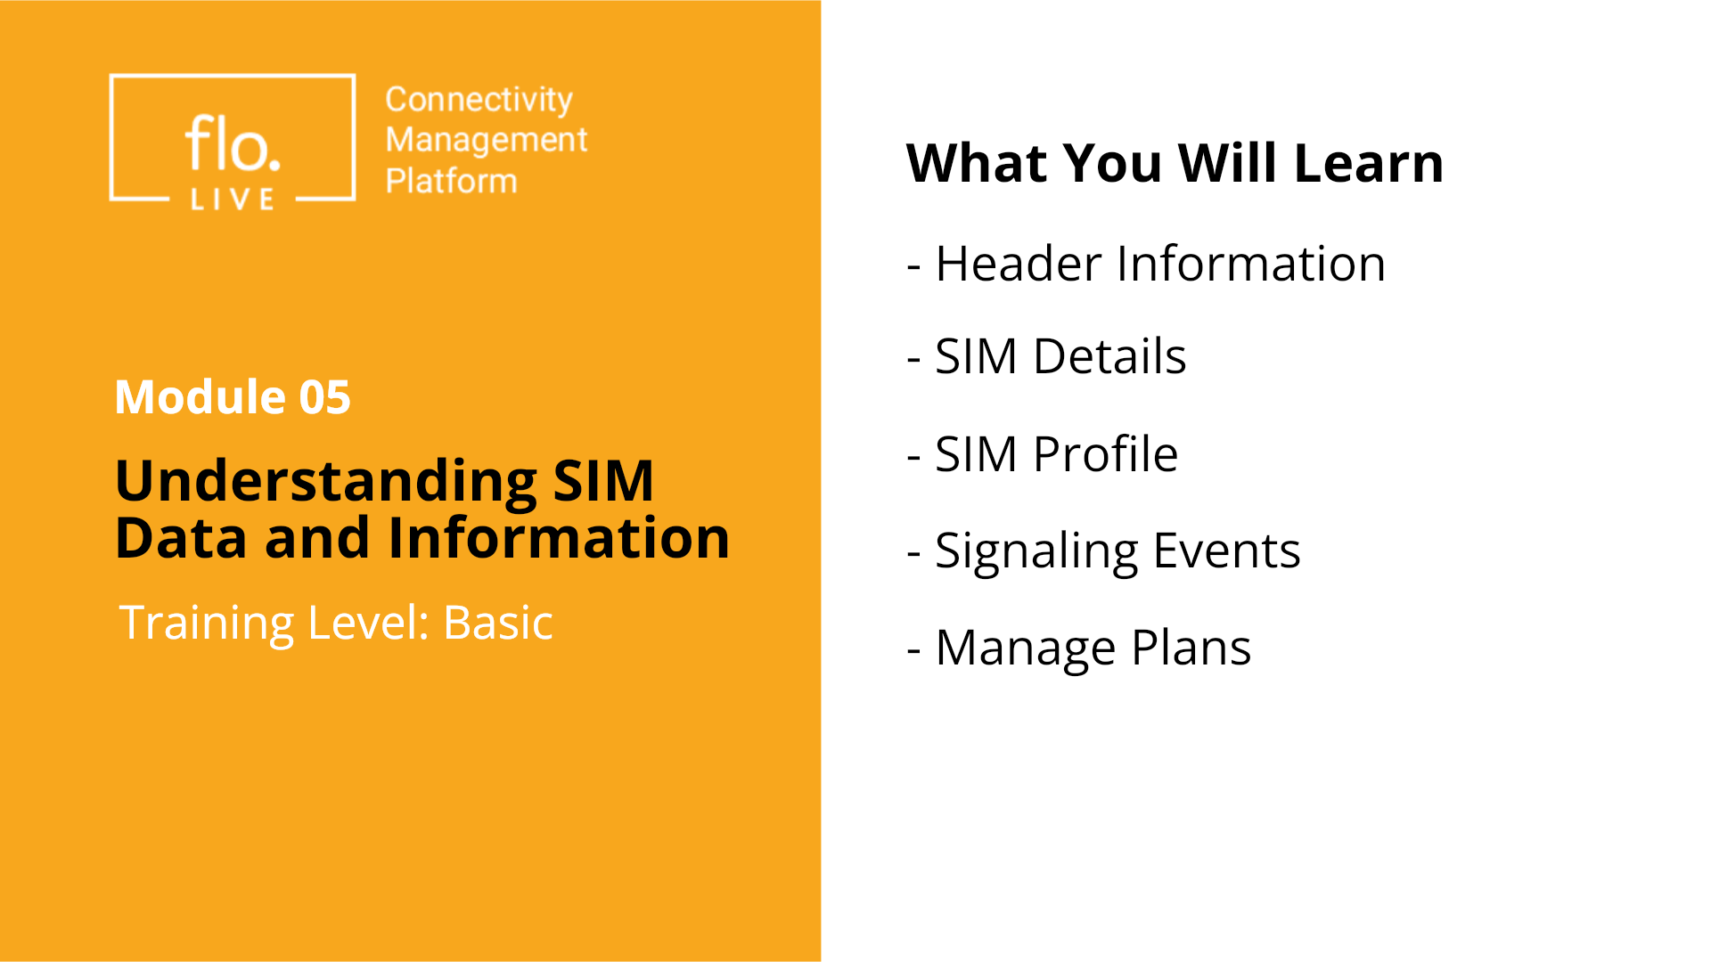
Notes:
In this tutorial, you will learn how to find detailed information for each SIM. We will cover the essential aspects, such as header information, SIM details, SIM profiles, signaling events, and finally, how to attach and manage plans.

Slide 3
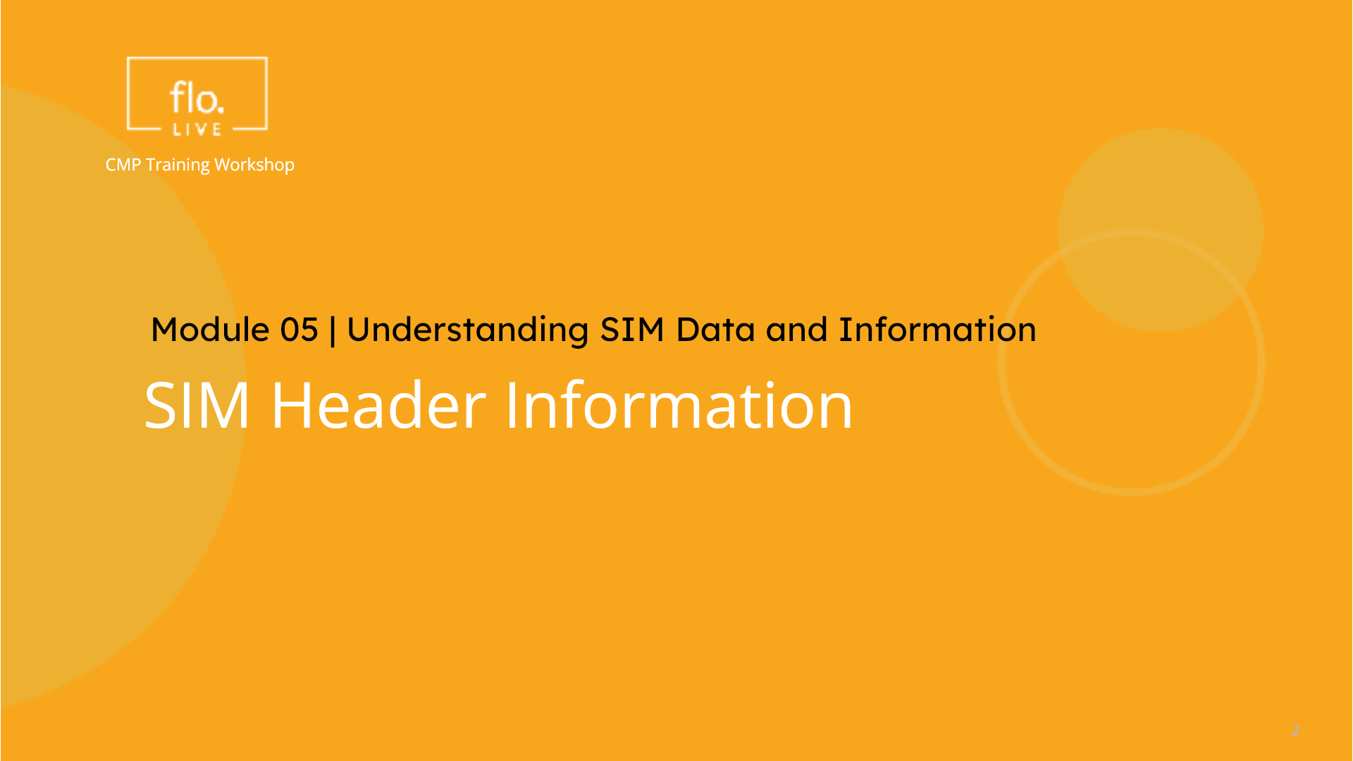
Notes:
We begin with a description of the SIM Header infomation.

Slide 4
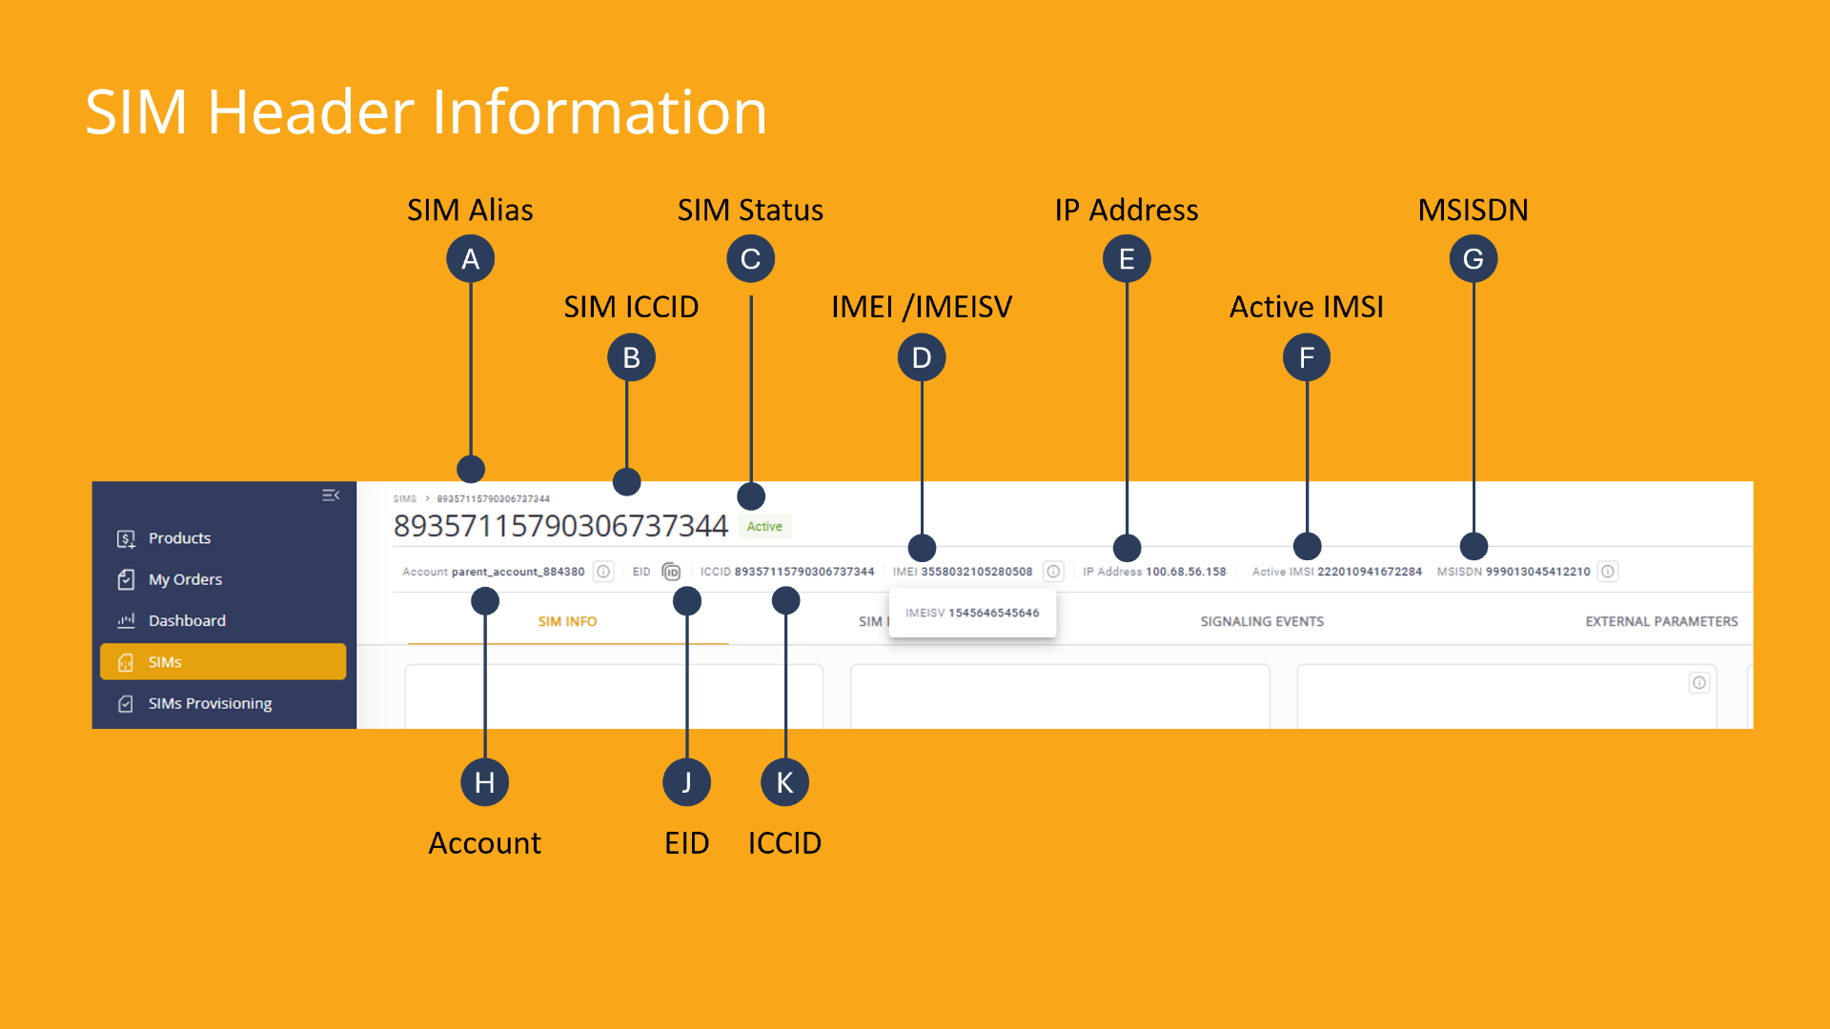
Notes:
The SIM header information contains important details related to your SIM card. The header displays the unique identifier, the associated account name, and current status. It also displays device-specific information such as the IMEI number and the last allocated IP address, along with the unique IMSI and associated phone number.

Slide 5
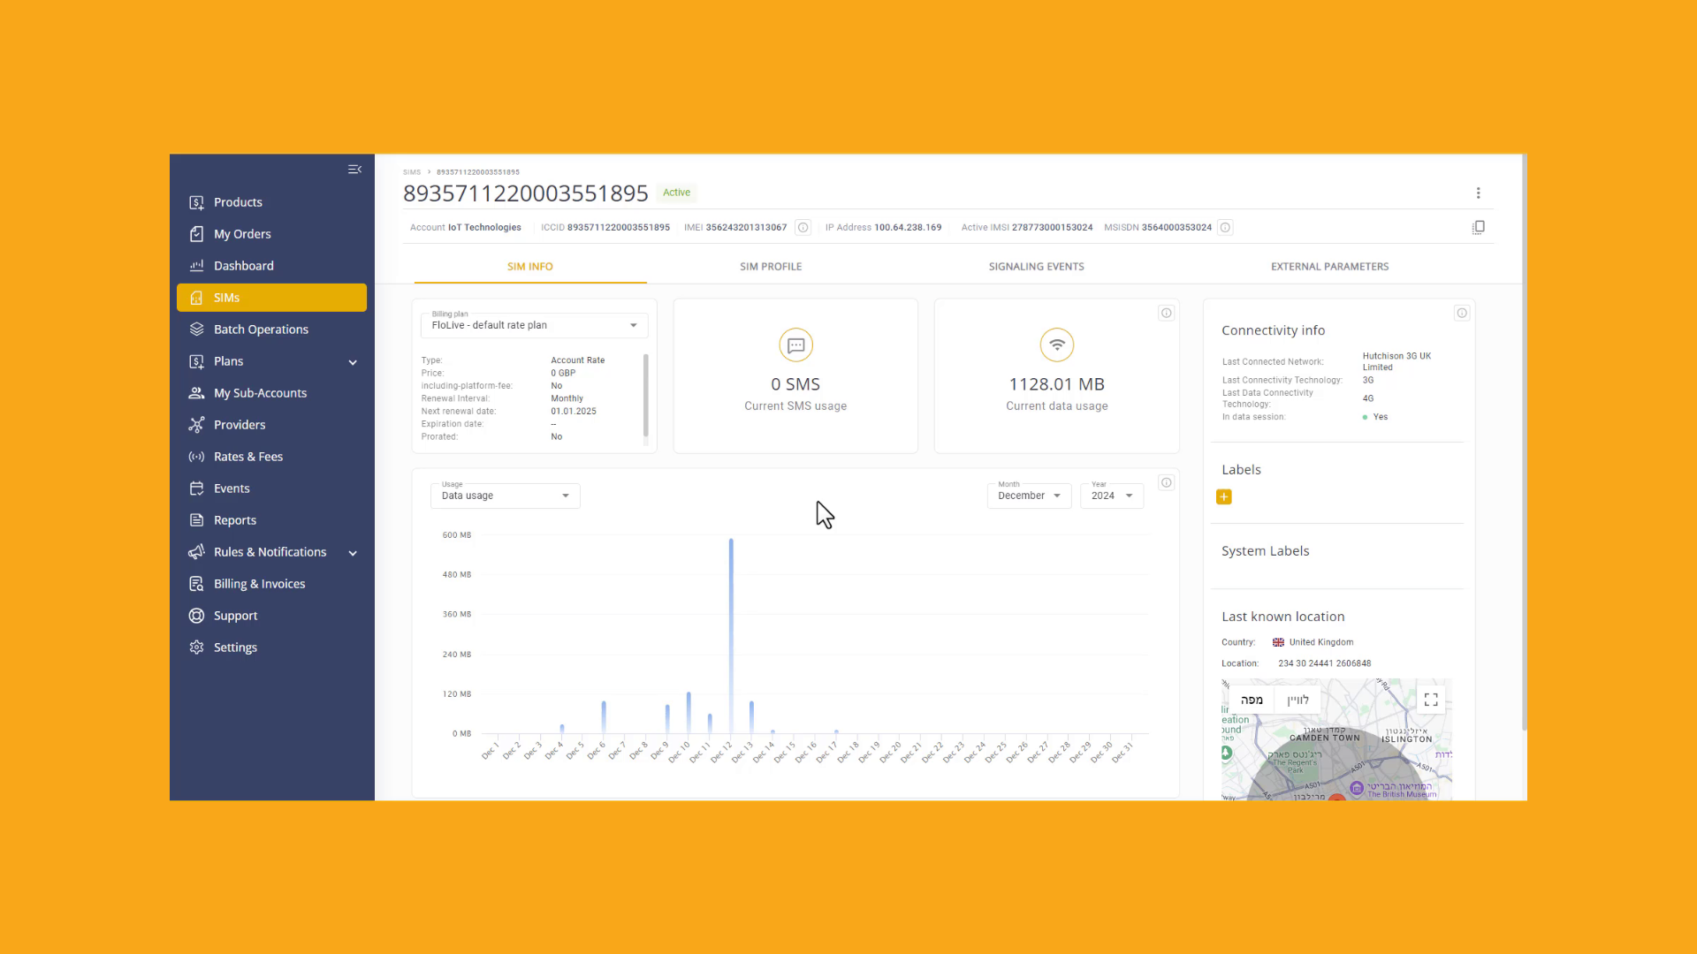
Notes:
Lets take a look at the SIM header information. At the top of the page, you can view the SIM Alias Name and status. The Account Name and SIM identification details are dislayed directly below. Pay attention to the SIM Actions menu on the right side of the screen. . Here you can perform various actions on the slected SIM card.

Slide 6
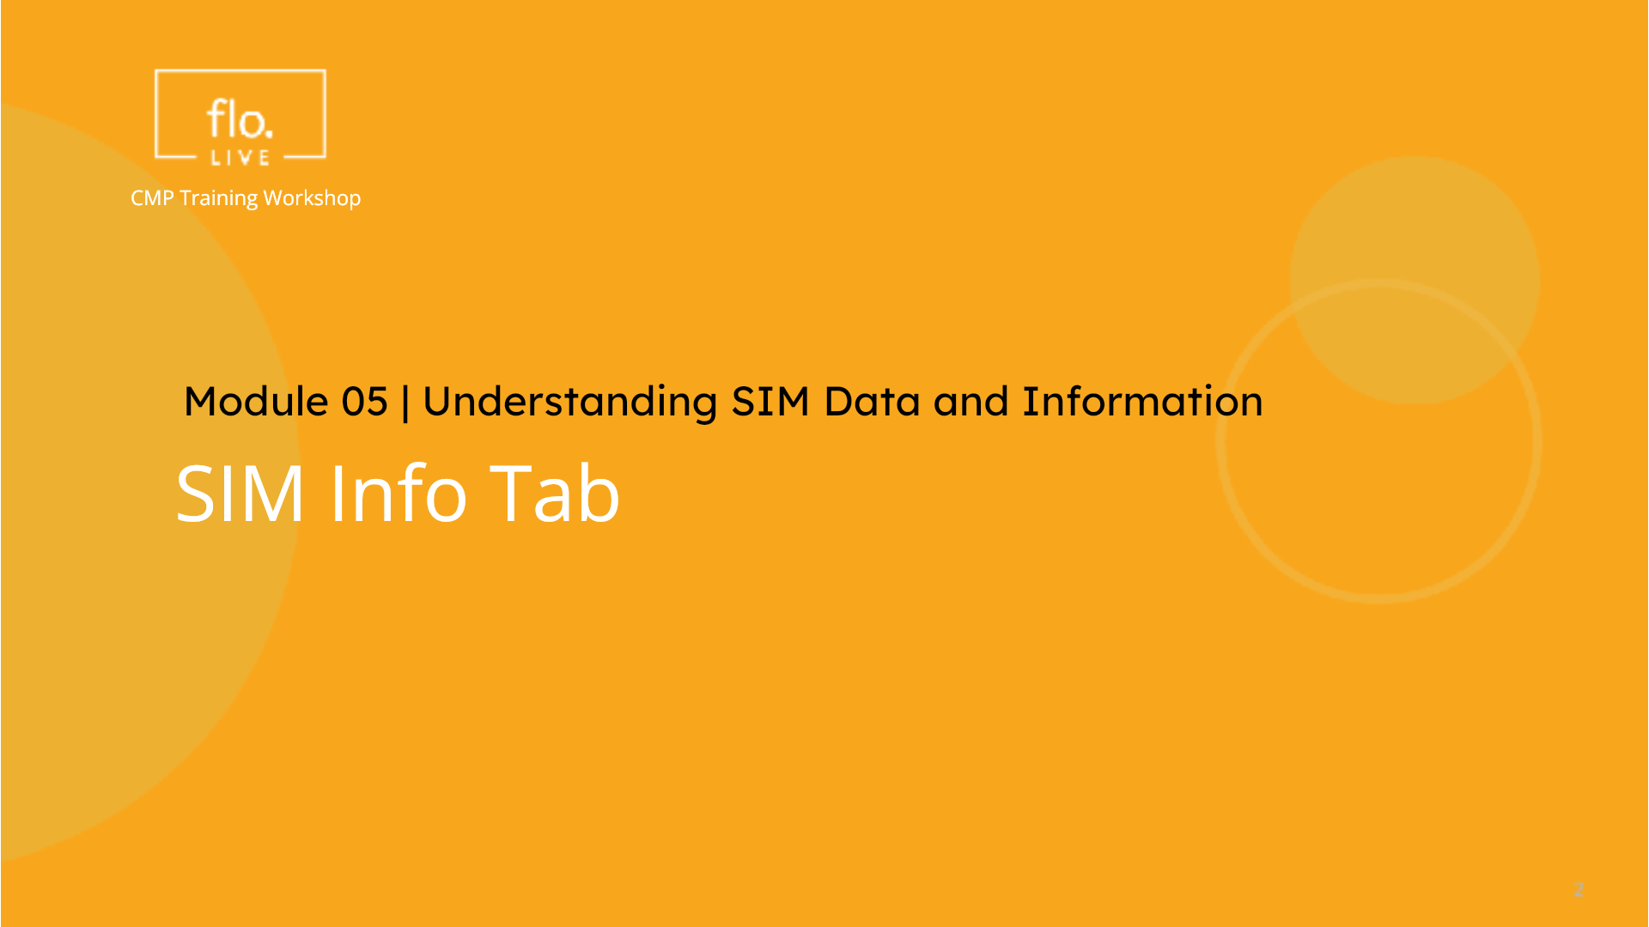
Notes:
Lets explore the information in the SIM Info tab.

Slide 7
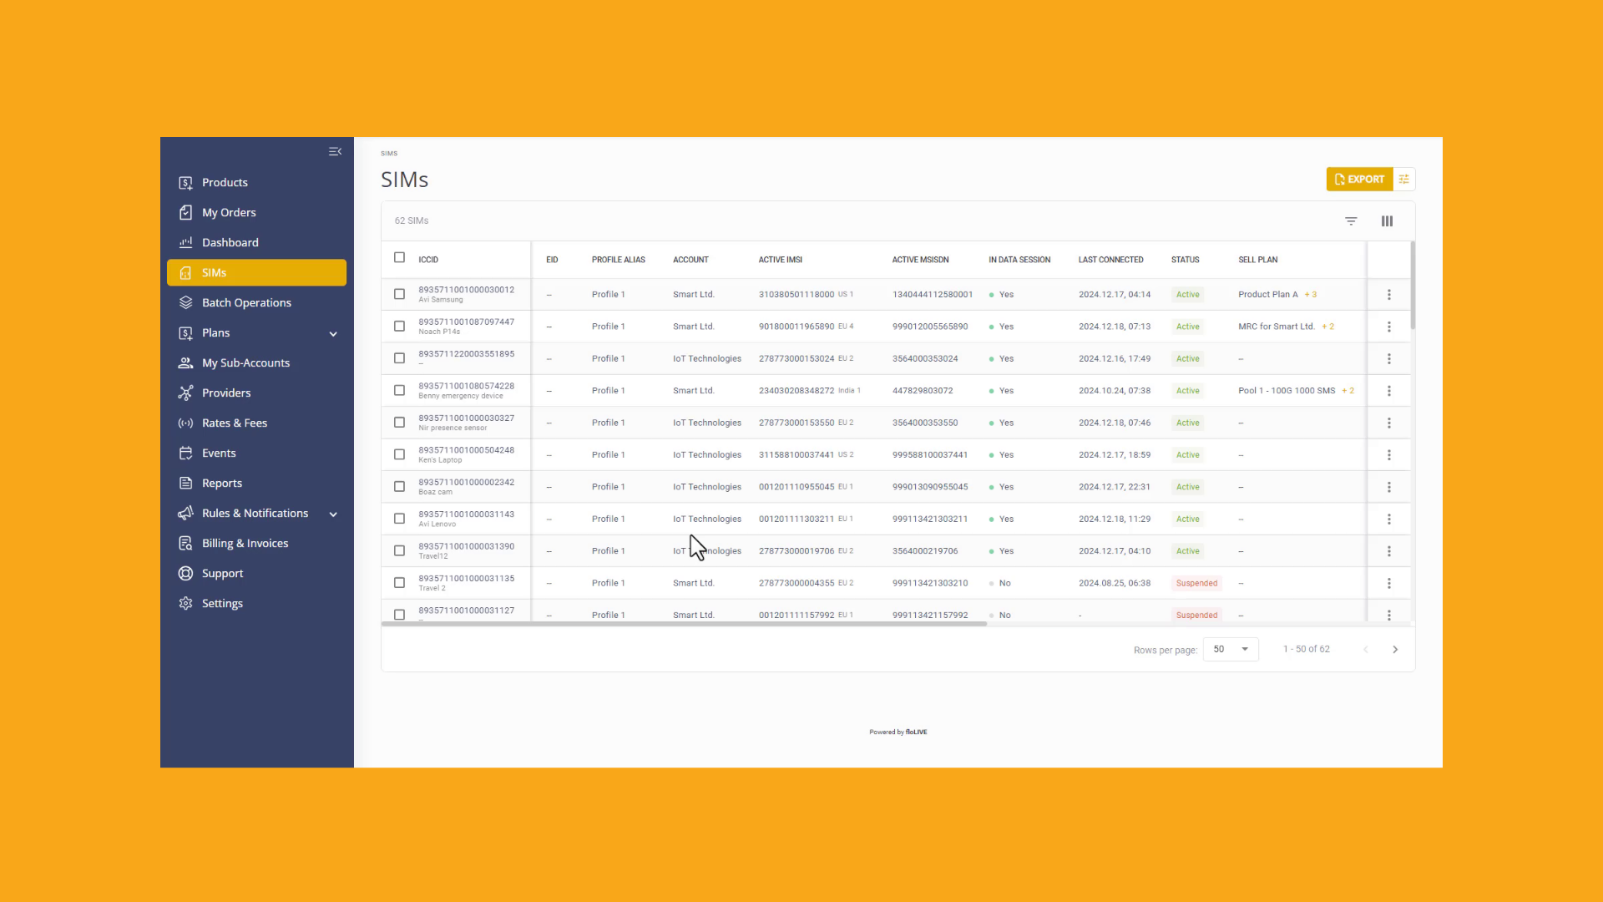
Notes:
The SIM Info tab is automatically displayed when you select a SIM from the SIM table. Here you can view the SIM Billing Plan data. . This indicator, shows the amount of available remaining data. The chart, visualizes the daily usage of SMS or Data for the specified month and year. You can go to the Connectivity panel and identify the name of the current, or last network the SIM was connected to. Finally you can identify the country and last known location where the SIM was used.

Slide 8
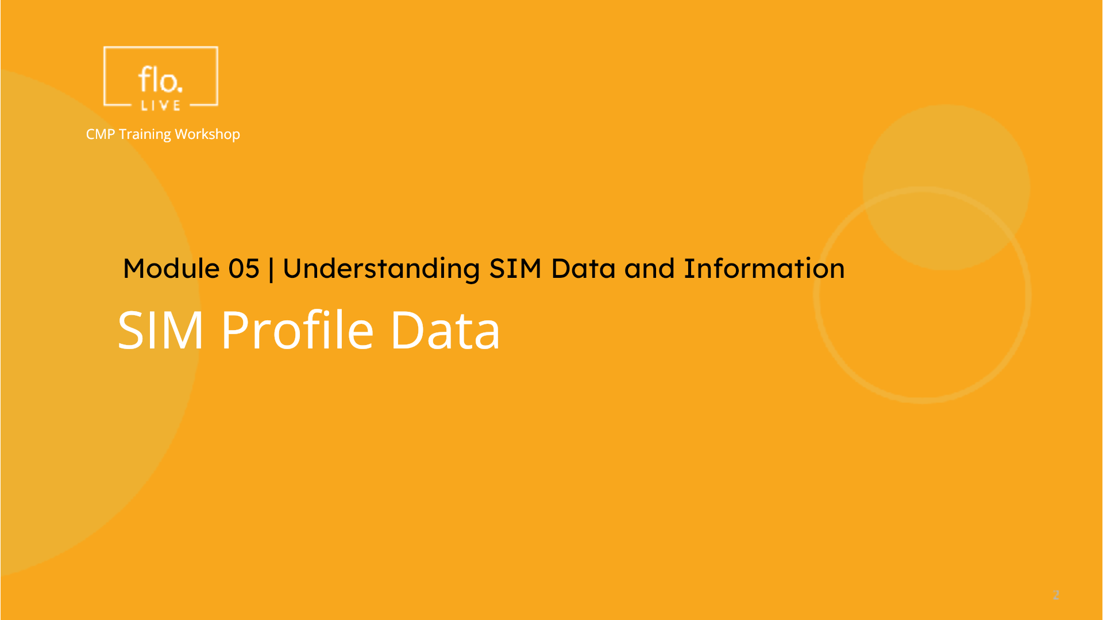
Notes:
To manage your SIM cards, you may need to access your SIM Profile data

Slide 9

Notes:
Select a SIM to view the SIM details page. , and click the SIM Profile tab. Here, you can view the UICC details. This SIM profile contains multiple IMSIs as displayed in this panel. / You can toggle this control to view all the IMSIs, or display only those IMSIs that are currently in use.

Slide 10
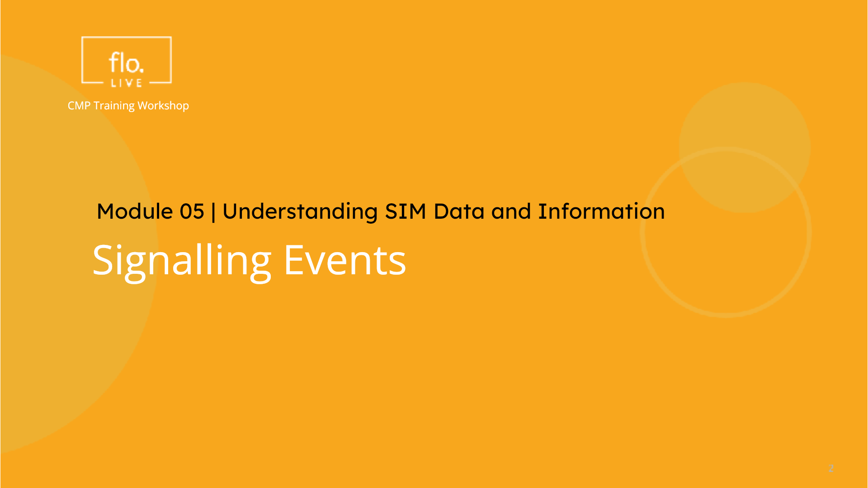
Notes:
Now, lets view the network signalling events generated by the selected SIM.

Slide 11
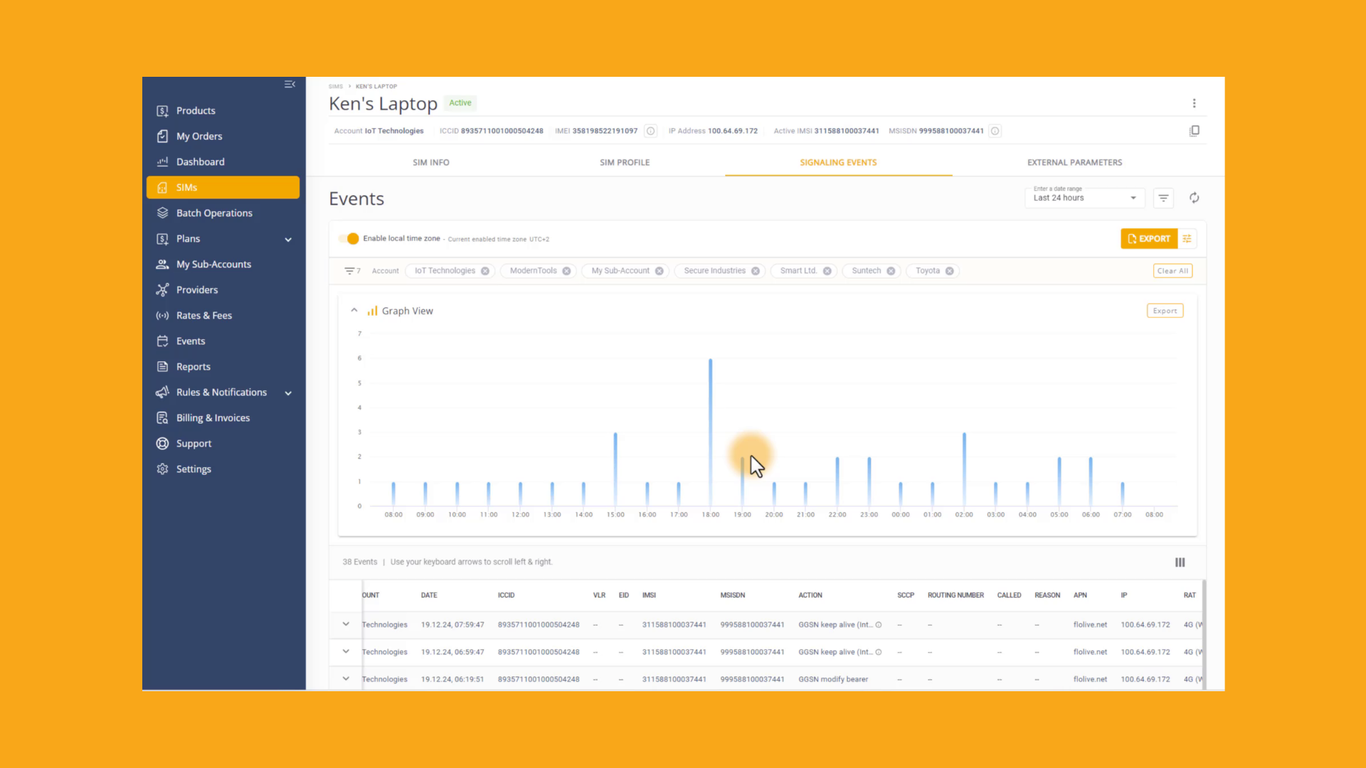
Notes:
/ / Select the Signalling Events tab. / // /Here, you can view a visualization of the signaling events generated by your SIM cards. You can also scroll the event details table. Each event is displayed in a separate row. / / / / / /Remember! you need to select an appropriate timeframe, / // / and enable the local timezone for accurate data. When analyzing the SIM signalling event table, you may want to filter the event data. Go to the Filter side panel, and select the appropriate criteria. . Dont forget, you need to click the Refresh control, to update the table data.

Slide 12
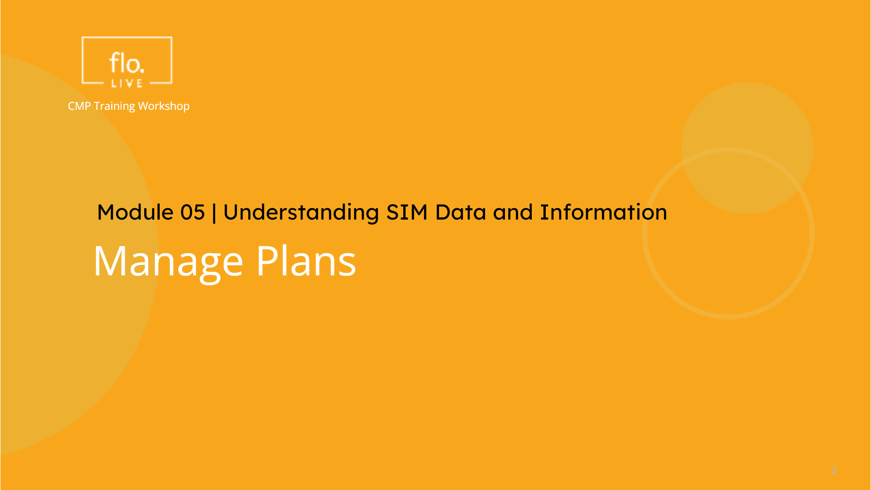
Notes:
In the final part of this tutorial, we will attach multiple plans to a selected SIM card.

Slide 13
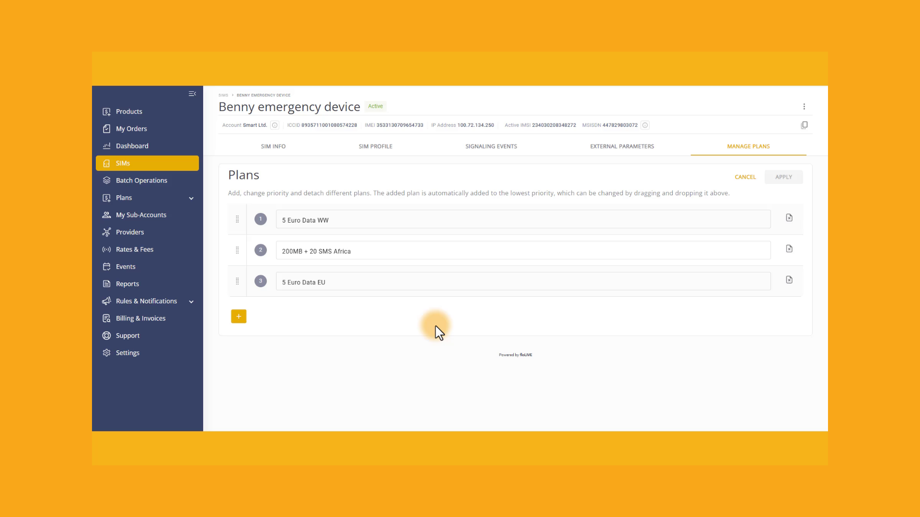
Notes:
Select the Manage Plans tab. Here you can see, there are three plans associated with the selected SIM card. . You can click on each item and select a different plan. . Make sure you click the Apply button after you make your changes. To change the order of priority, simply drag and drop a plan and place it in order of priority, from highest to lowest. To remove a plan, click the Delete icon. To attach a new plan to the SIM, click the Plus sign. THe CMP system enables you to attach up to 4 planse to each SIM card.

Slide 14

Notes:
Thank you for watching this video tutorial. For more information about the CMP system, make sure you visit our Knowledge-base that is accessible directly from the CMP Portal.

